Slide 9
Chart Examples

Slide 10
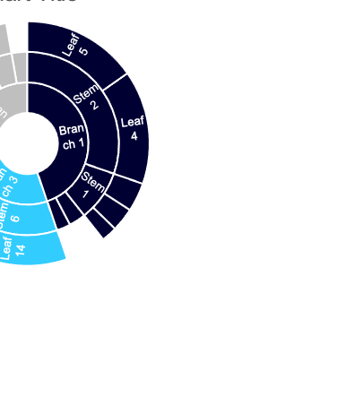
Chart Examples

Slide 11
Chart Examples

Slide 12
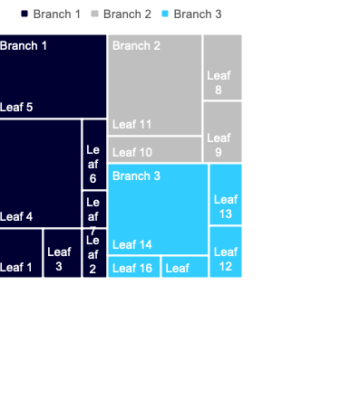
Chart Examples

